Slide 1
LSTM (Cont’d)
Instructor: Dr. Yan Yan

Slide 2
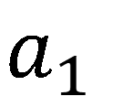
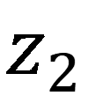
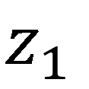
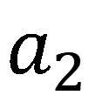
Original Network:
Simply replace the neurons with LSTM
……
……
$$a_{1}$$
$$a_{2}$$
$$z_{1}$$
$$z_{2}$$
x₁
x₂
Input

Slide 3
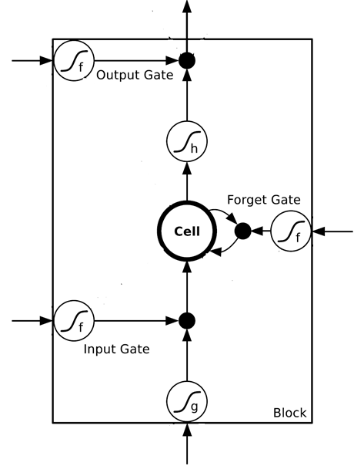
$$a_{1}$$
$$a_{2}$$
+
+
+
+
+
+
+
+
4 times of parameters
x₁
x₂
Input

Slide 4
LSTM
c^{t-1}
……
vector
z^{f}
z^{i}
z
zº
4 vectors
x^{t}

Slide 5

LSTM
y^{t}
zº
c^{t-1}
×
＋
×
$$×$$
$$＋$$
$$×$$
×
z^{f}
$$×$$
z^{i}
z^{f}
z^{i}
z
zº
x^{t}
z

Slide 6
LSTM
Extension: “peephole”
y^{t}
y^{t+1}
c^{t-1}
c^{t}
c^{t+1}
×
＋
×
×
＋
×
×
×
z^{f}
z^{i}
z
zº
z^{f}
z^{i}
z
zº
c^{t-1}
h^{t-1}
x^{t}
c^{t}
h^{t}
x^{t+1}

Slide 7
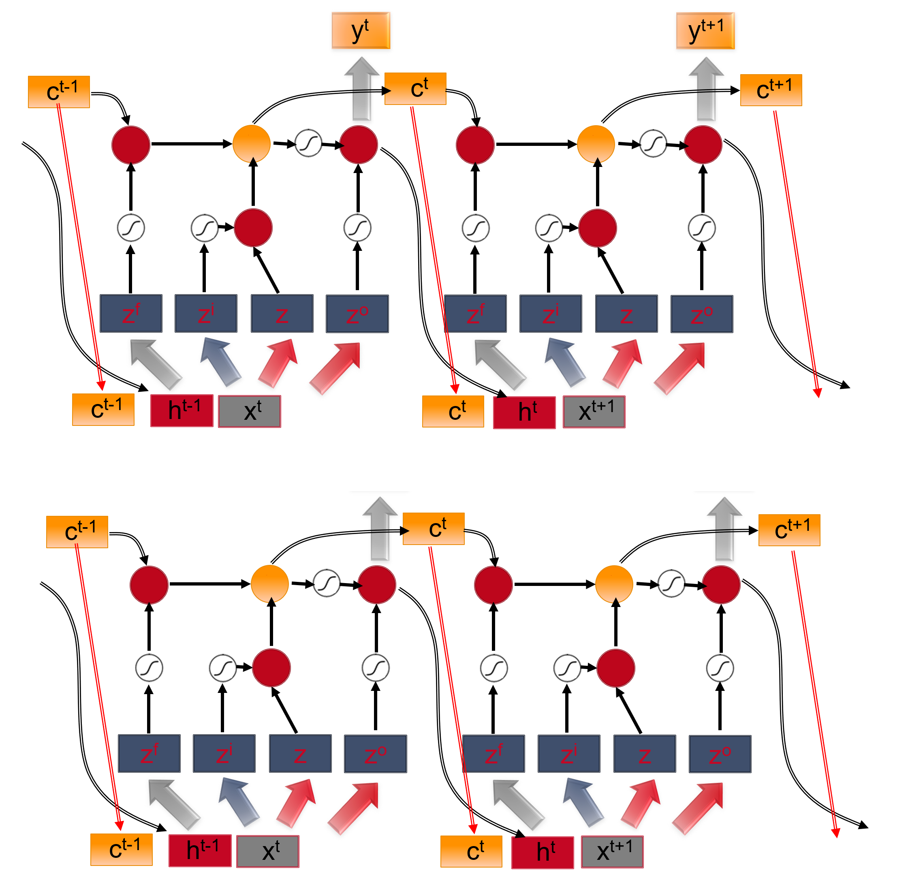
Multiple-layer LSTM
What is this?
Don’t worry if you cannot understand this. Keras can handle it.
Keras supports
“LSTM”, “GRU”, “SimpleRNN” layers
This is quite standard now.
https://img.komicolle.org/2015-09-20/src/14426967627131.gif

